Slide 1

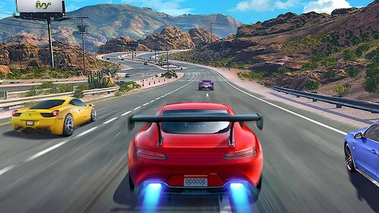
Bangladesh University of Business And Technology
Car Racing Game

Slide 2
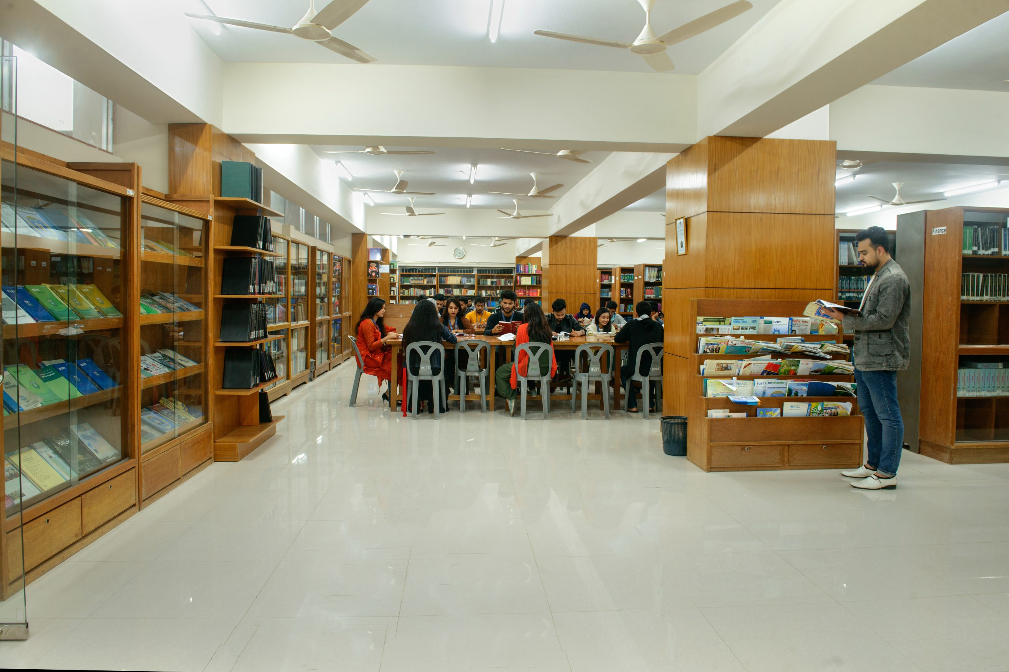



Presented By
sir
Supervised By
Sheikh Moonwara Anjum Monisha
Lecturer of BUBT
Department of Computer Science & Engineering(BUBT)
Md.Abu essa
ID:19202103265
Md Mehedi Hassan ID:19202103264
Md Ebrahim Emon
ID 19202103253
Radiya Binte Reza ID:19202103246

Slide 3







01. Introduction
5. Conclusion
02.Components & Software Requirement
Car Racing Game
04.Output
03. Working Principle

Slide 4


01. Introduction
Good afternoon, everyone. Today, I want to talk to you about car racing game. Car racing games are one of the most popular genres in the gaming industry. In these games, players take on the role of a professional race car driver, competing against other drivers on a variety of tracks and terrains.
What makes these games so exciting is the fast-paced action and the need for precision driving skills. Players must navigate through challenging courses, avoid obstacles, and outmaneuver their opponents to cross the finish line first. One of the great things about car racing games is that they can be enjoyed by players of all skill levels.

Slide 5


02.Components & Software Requirement
Laptop/PC
Computer Mouse
Keyboard
VS Code or Pycharm
Extensions : Pygame,Time, Random

Slide 6


03. Working Principle
1. INSTRUCTION
2. START
3.QUIT

Slide 7
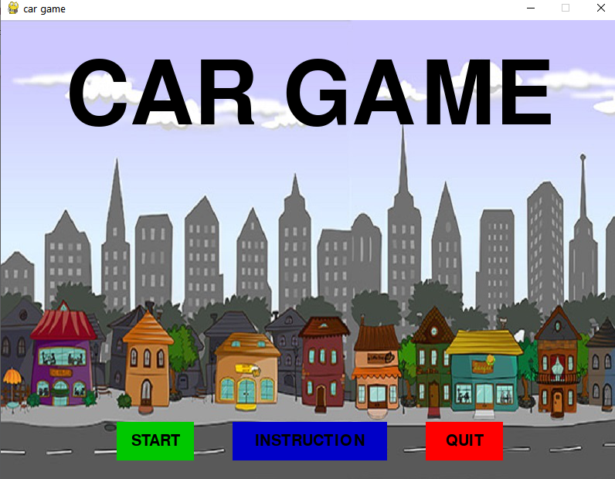
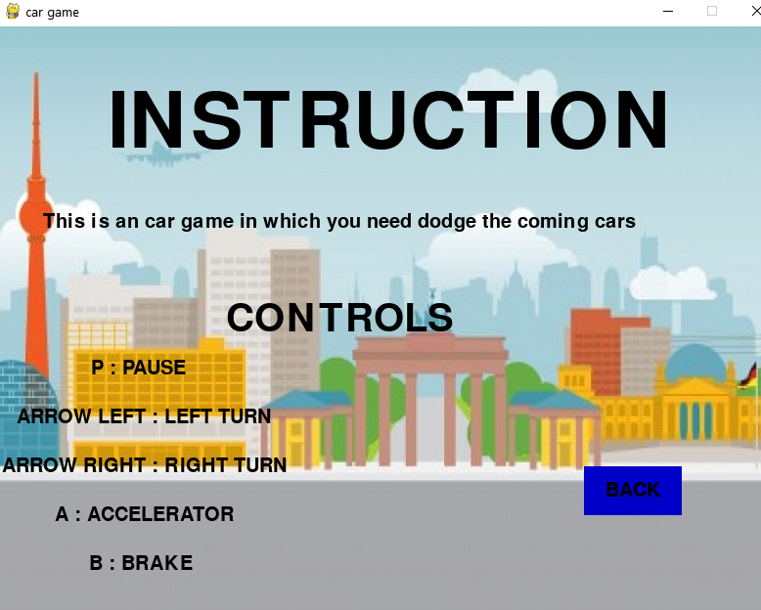
03. Working Principle (INSTRUCTION )
1. INSTRUCTION : When we run the program we will see one new window. In this window there will be 3 buttons 1st instruction 2nd start and last one is exit or quit button. When we click on the instruction button we will see the Controls for car racing system. For example how to drive, how to go to the right, left side. How to speed up and speed down. and how to back from instruction page to previous page.

Slide 8
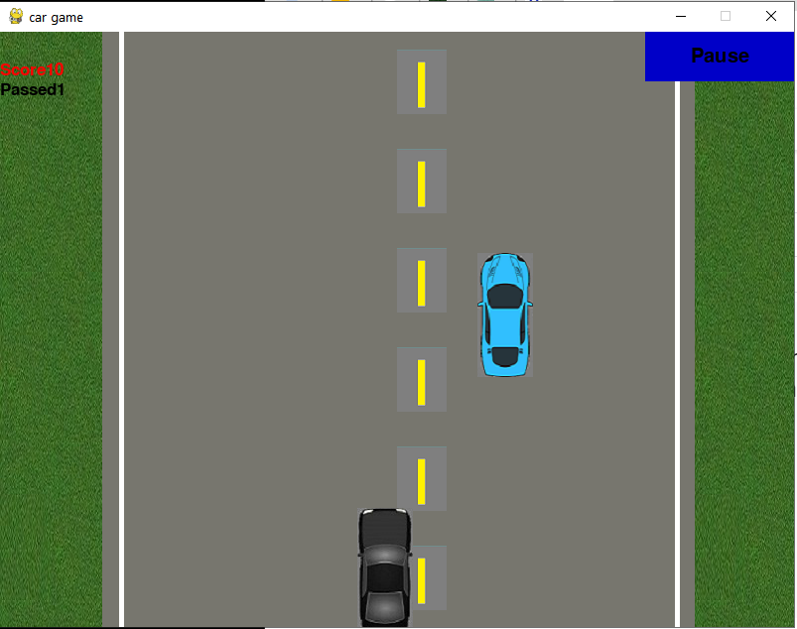
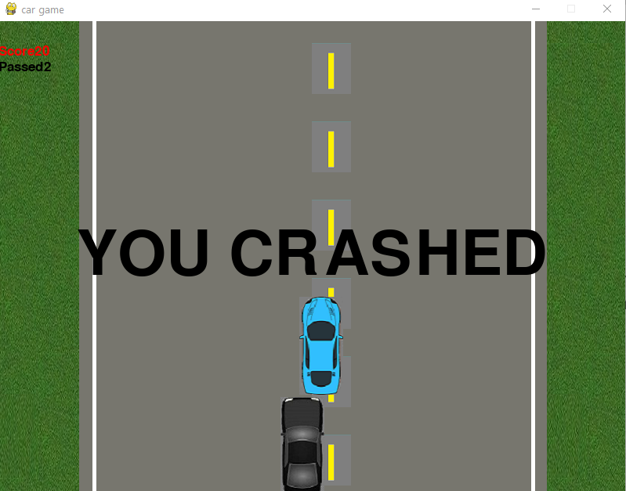
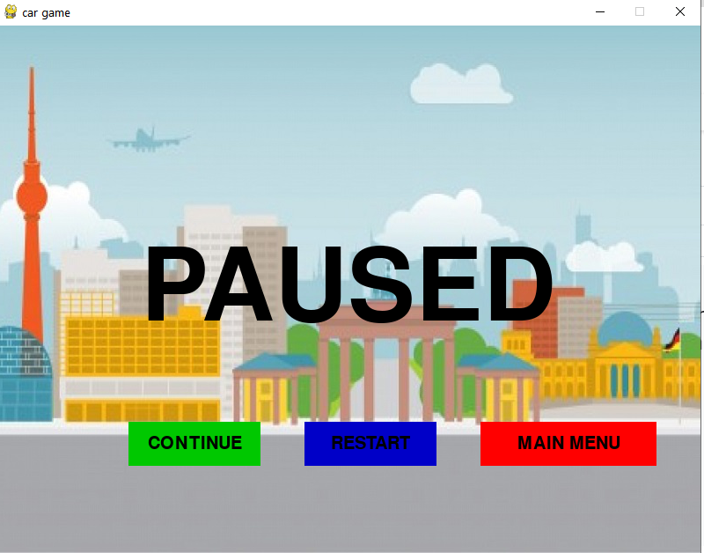
03. Working Principle(START )
2. START:

Slide 9
04.Working principal
3.QUIT: When we click the Quit button we will exit the game.

Slide 10


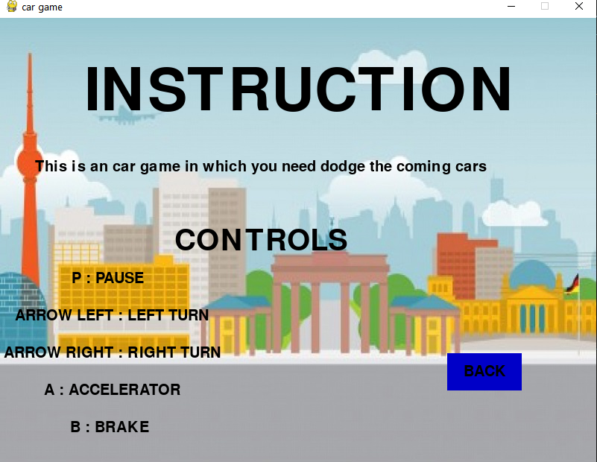
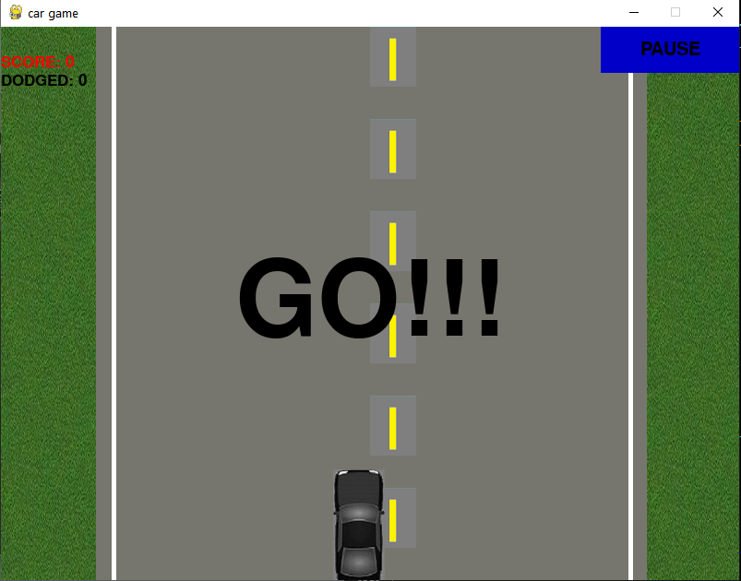
5. Output

Slide 11

5. Conclusion
"In conclusion, the car racing game we've presented today demonstrates the power and flexibility of Python for developing engaging and interactive applications. With its rich ecosystem of libraries Python provides a robust and efficient platform for building complex games with advanced features and functionality. Overall, we believe that this car racing game is a great example of how Python can be used to create fun and innovative games that push the boundaries of what's possible. We hope that this presentation has inspired us to explore the world of game development using Python and to discover new ways to harness the power of this amazing programming language."

Slide 12


Slide 13

ANY QUESTION

